Slide 1

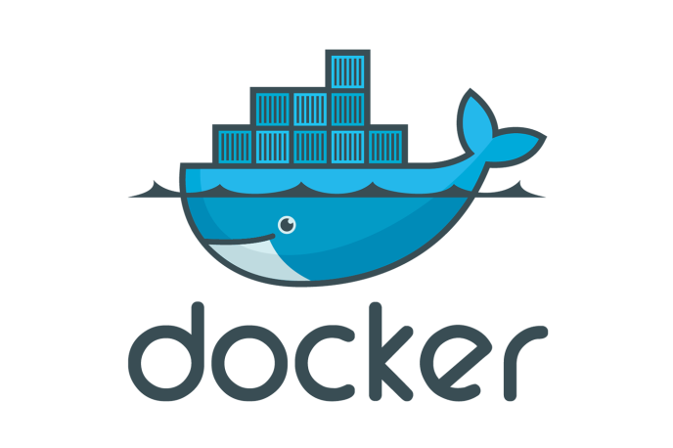
Docker- Quick Intro
Docker Introduction and Fundamentals
This course focuses on important concepts of Docker.
The different components used in Docker
Real world Problems that Docker attempts to solve.

Slide 2
What is covered as a part of the Docker course?
Docker components
Docker Concepts
Docker Engine
Docker Hub
Docker Machine
Docker Compose
Docker Swarm (Not covered)
Kitematic (Not covered)
Docker Container
Docker Images
Docker Volumes
Docker commits/tags/push/pull
Docker command line (CLI)
Introduction

Slide 3
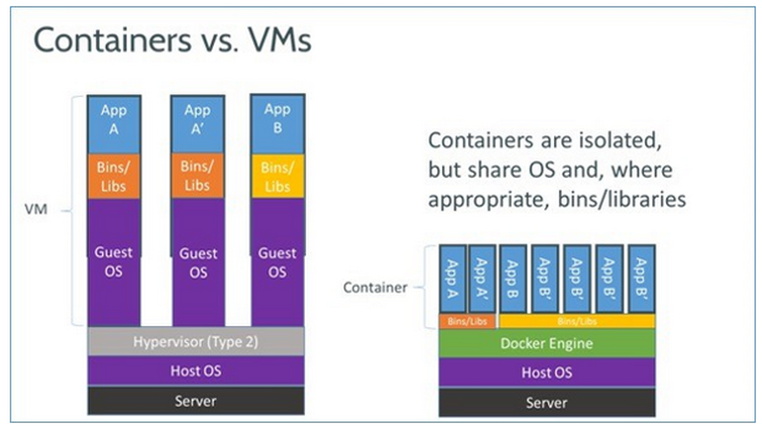
What is Docker, how is it different from other Virtualization technologies available?
Docker is a platform for developing, shipping and running applications using a container based Virtualization technique.
Docker
Runs the same operating system as the Host OS.
This allows it to share a lot of host operating system resources.
In order to achieve this they originally used LXC (LinuX Containers) but later moved to runC (aka libcontainer).
AuFS is a layered file system, so you can have a read only part and a write part which are merged together. One could have the common parts of the operating system as read only (and shared amongst all of your containers) and then give each container its own mount for writing.
Virtual Machines
A full virtualized system gets its own set of resources allocated to it, and does minimal sharing.
You get more isolation, but it is much heavier (requires more resources). With docker you get less isolation, but the containers are lightweight (require fewer resources).
Introduction

Slide 4
Want to know more differences?
Google on “How is Docker different from a normal virtual machine?” , click on the first link on stackoverflow.com to get a more detailed understanding of docker vs virtual machines.
http://stackoverflow.com/questions/16047306/how-is-docker-different-from-a-normal-virtual-machine
Introduction

